Slide 1
Data Science (DK5) Wave 2 TTH Capstone ___ Best Public Schools in Maryland
Author: Yan Zhu

Slide 2
Data Science Workflow
Identify the problem
Acquire the data
Parse the data
Refine the data
Mine the data
Build a model
Present the findings
2. EDA
3. Model
4. Test
5. Present
1. Problem

Slide 3
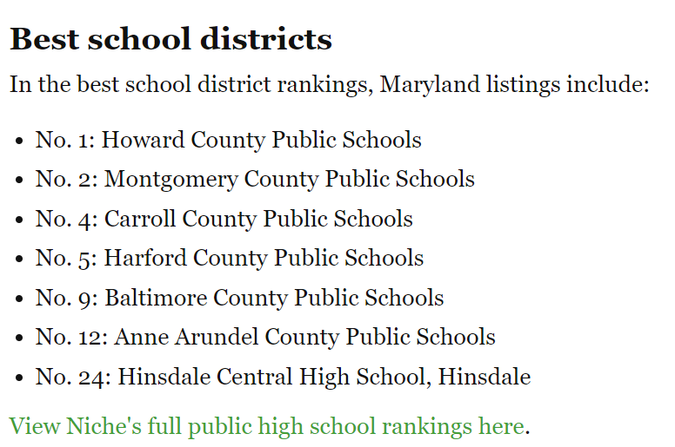
Identify the problem
Interest: Determine MD school district with best school ratings, has all 3 school levels, and highest number of Asian population.
Potential Audience: Parents, educators, policy makers.
Challenge: Missing data since not all schools have ratings on GreatSchools.org. Data is also a bit dated so the results are not the latest. Multiple sources with different rating system (USNews.com, Niche.com, schooldigger.com, GreatSchools.org, etc.) with varying parameters used to determine rating (demographics on parents, location, teacher rating, extracurriculum programs etc).
High Schools
#1. Poolesville
#2. Walt Whitman
#3. Winston Churchill
#4. Richard Montgomery
#5. Thomas S. Wootton
#6. River Hill
#7. Walter Johnson
#8. Montgomery Blaire
Middle Schools
#1. Cabin John
#2. Burleigh Manor
#3. Folly Quarter
#4. Mount View
#5. Lime Kiln
#6. Herbert Hoover
#7. Clarksville
#8. Takoma Park
Elementary Schools
#1. Carl Sandburg
#2. Waverly
#3. Seven Locks
#4. Northfield
#5. Wayside
#6. Stone Mill
#7. Clarksville
#8. Cold Spring
Source: Niche.com

Slide 4
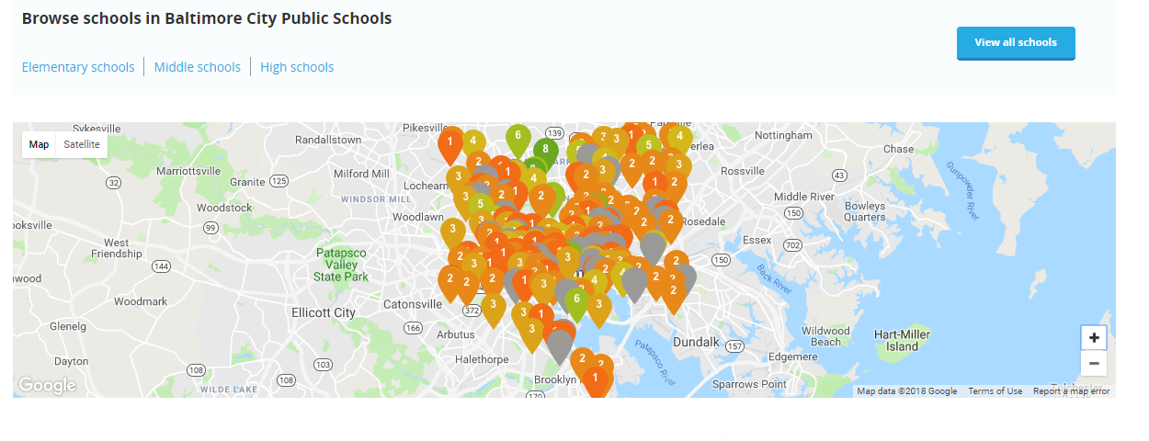
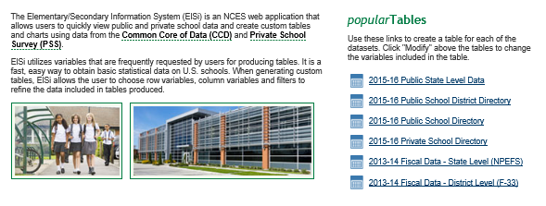
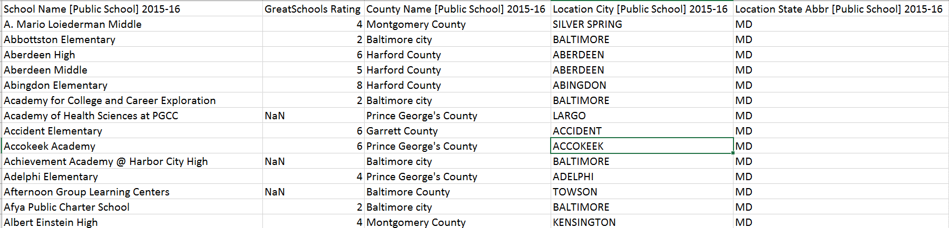
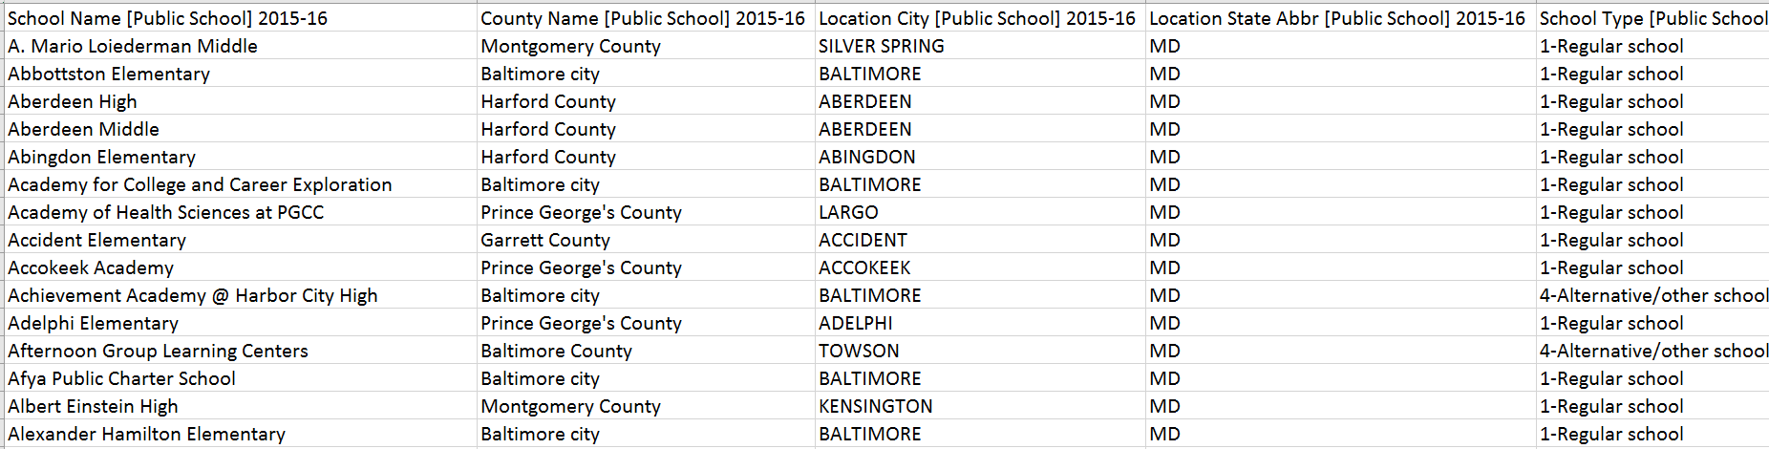
Acquire the data
Demographics were extracted from National Center for Education Statistics (latest is from 2015-2016) and Ratings were manually gathered from GreatSchools.org.
National Center for Education Statistics (NCES) is the primary federal entity for collecting and analyzing data related to the education in the U.S and other nations.
GreatSchools.org is the leading national nonprofit that gather school information and developed rating algorithms to empower parents to unlock educational opportunities for their child.
https://nces.ed.gov/ccd/elsi/
GreatSchools.org
Variable = rating
Variable = school

Slide 5
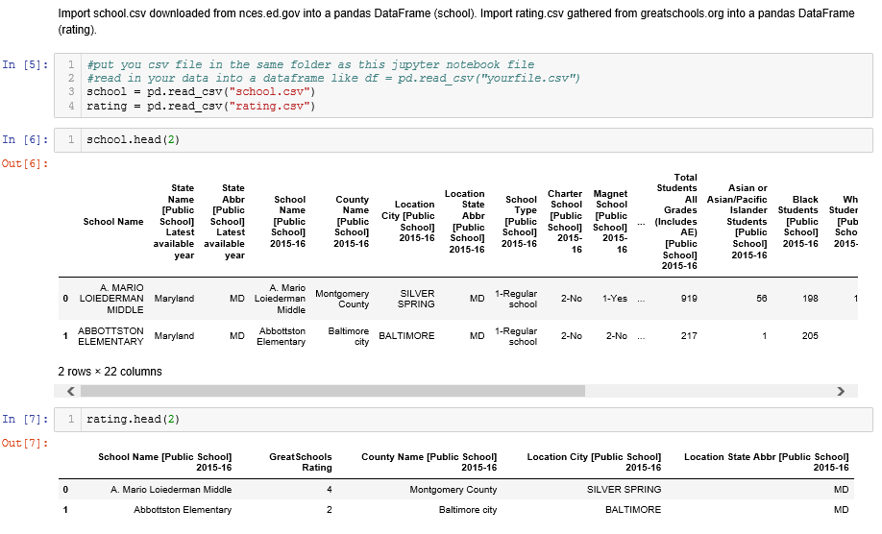

Parse the data
Using pd.read_csv to import both school and rating CSV files. Then combine two datasets using pd.merge.
Use .head(), dtypes(), .info() to describe the basic format of the data and the columns

Slide 6
Refine the data
Use .columns to example column names and map it into a data frame to identify column index. Use .drop(…, axis=1) to drop unwanted data.
School name and State names appear multiple times
Total Students All Grades is the same as the Total Race/Ethnicity
Very descriptive columns but wanted to view all of the data in one frame so use .rename() to shorten title.
Remove [Public School], 2015-16
There are several missing entries within the datasets. Not all schools have a rating and NCSE is missing some data as well.
Replace '†','–','‡','NR' with NaN.
Drop null values using .dropna(inplace=True)
Make sure all students counts are integers using int(float(x)) and all ratios are floats using float(x)
To make the columns more useful, convert # of students to ratio by dividing each demographics by the total # of students.

Slide 7
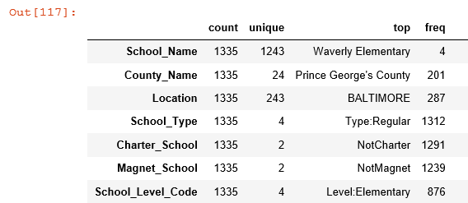
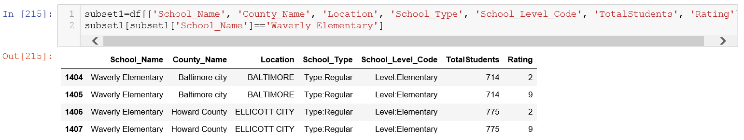
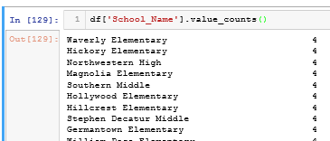
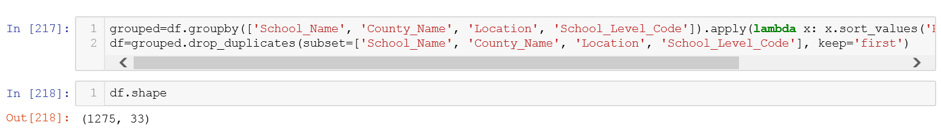
Mine the data
Using .describe(include=‘all’) to find summary statistics for each variables.
School Names are not unique. 7% of school names have duplicates. This could be attributed to same school names in different district. Let’s explore further…
60 duplicates were found and removed via groupby().apply() and drop_duplicates()
1 -
3 -
2 -
4 -

Slide 8
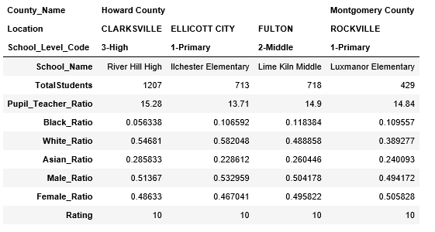
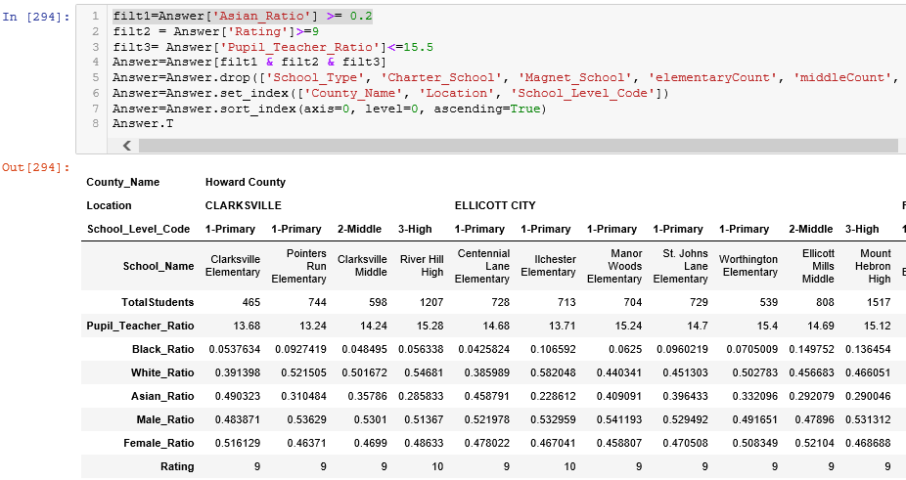
Best Public Schools in MD
Determine MD school district with best school ratings, has all 3 school levels, with lowest pupil to teacher ratio and the highest number of Asian population
Use groupby().apply() to group school levels by county name and location. Use .drop() and merge() filter out districts that does not have at least 1 elementary, 1 middle, and 1 high and reduced dataset by 300 schools.
Use conditions (rating = 10, Asian >= 20%, and Pupil_Teacher ratio <= 16, Howard County is the only district in Maryland with all 3 schools that fit the criterion.
Because of the schools are not located in the same city within the district, we had to expand the conditions (rating >=9, Asian >= 20%, Pupil to Teacher ratio <=16), we found 17 schools that fit the criterion. Both Clarksville and Ellicott City have all 3 schools and meet the criterion that we set above.

Slide 9
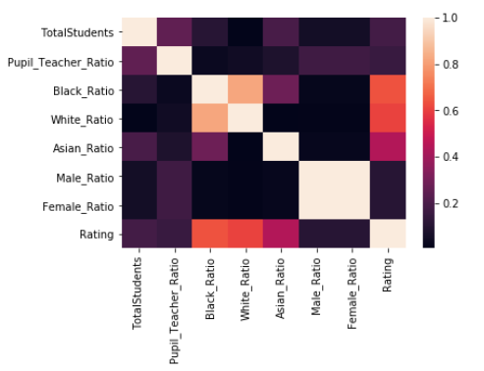
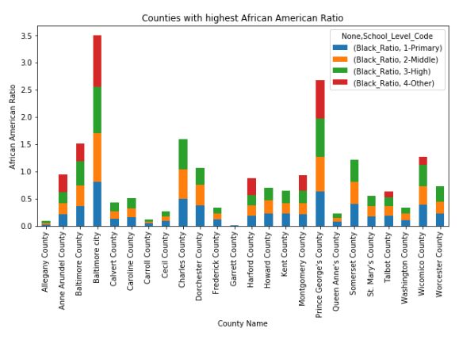
Correlation
Using groupby() and unstack() to break district down by demographics. Then used a bar graph to find the county district with highest concentration of demographics
Using a seaborn correlation plot, it was determined African American ratio has the highest negative correlation to school rating.

Slide 10
Build a model
Convert Charter School, Magnet School, and School Types to Dummy Variables.
Inputs: ratio of Asian students, ratio of African American students, ratio of Caucasian students, ratio of student to teacher, charter school, magnet school, and school type
Outputs: school ratings
Use Train-Test-Split to split up date into
train and test set.
Use 3 supervised machine learning models:
LinearRegression, KNNRegression, and
RandomForestRegression
Determine the R² score of each model.
 | Linear Regression | KNN Regression | Random Forest Regression
Definition | In statistics, linear regression is a linear approach to modelling the relationship between a scalar response and one or more explanatory variables. | In pattern recognition, the k-nearest neighbors algorithm is a non-parametric method used for classification and regression. | A random forest is a meta estimator that fits a number of classifying decision trees on various sub-samples of the dataset and use averaging to improve the predictive accuracy and control over-fitting.
R² | 0.57 | 0.44 | 0.61

Slide 11
Conclusion
Through multiple testing, test size of 35% resulted in the highest scores in all 3 models.
Through a for loop, found 9 nearest neighbors produces the best score for KNN Regression model.
Random Forest Regressor has the highest score values out of all 3 models because this model considers the importance of each variable in improving the prediction.
Random Forest Regressor identified Caucasian, African American, Asian are the most important variables to consider. This matches our correlation plot.
Although they were identified as the important variables, It is difficult to make conclusion about the school rating is based on race demographics alone because there are several other factors that are not available/considered within this dataset.
For example, African American students tend to be in school district (specific Baltimore City) where there are poor living conditions which could attributes to lack of resources and proper learning environment that can lead to poor school rating.
Furthermore, African American students often lacks parental engagement which leads to low attendance and thus poor school rating.

Slide 12

Next Steps
Gather more data!! Consider additional variables such as test scores, attendance, parental involvements in the school, school funding, extracurricular activities available to the students, parental finance, neighborhood demographics to name a few.
Create a coordination between school ratings and housing market prices.
\\\\\\\\\\\\\\\\\\\\\\\\\\\\\\\\\\\\\\\\\\\\\\\\\\\\\\\\\\\\\\\\\\\\\\\\\\\\\\\\\\\\\\\\\\\\\\\\\\\\\\\\\\\\\\\\\\\\\\\\\\\\\\\\\\\\\\
\
\\\\\\\\\\\\\\\\\\\\\\\\\\\\\\\\\\\\\\\\\\\\\\\\\
\\\\\\\\\\\\\\\\\\\\\\\\\\\\\\\\\\\\\\\\\\\\\\\\\\\\\\\\\\\\\\\\\\\\\\\\\\\\\\\\\\\\\\\\\\\\\\\\\\\\\\\\\\\
\\\\\\\\\\\\\\\\\\\\\\\\\\\\\\\\\\\\\\\\\\\\\\\\\\\\\\\\\\\\\\\\\\\\\\\\\\\\\\\\\\\\\\\\\\\\\\\\\\\\\
\\

